Slide 1
Overview
This project focuses on the analysis of Zomato’s customer base and their customer’s purchase patterns through the use of :
Demographic customer analysis
RFM customer analysis
The goal was to find out what are Zomato’s least purchased cuisines. The RFM analysis would provide an understanding on why the cuisines with the lowest sales should be focused on more by the marketing team to improve profits from their lower sellers.
Who is Zomato?
Zomato is a multinational restaurant aggregator and food delivery company.

Slide 2
Demographic Segmentation
This dashboard provides information on distinct customer segments based on the following:
Demographic factors, including age, gender, education level, occupation, and marital
status.
Trend analysis of monthly purchase frequency to identify seasonality in purchase
behavior.
A comparison between average sales quantity vs. average sales amount based on
customers’ income level.
This data can be further filtered based on customer base age group and gender.

Slide 3
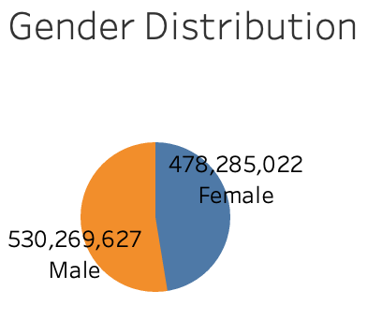
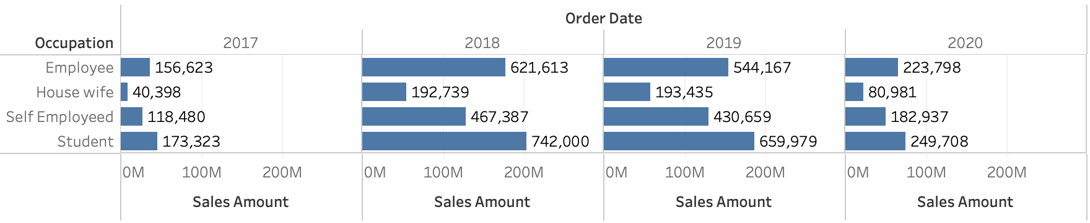
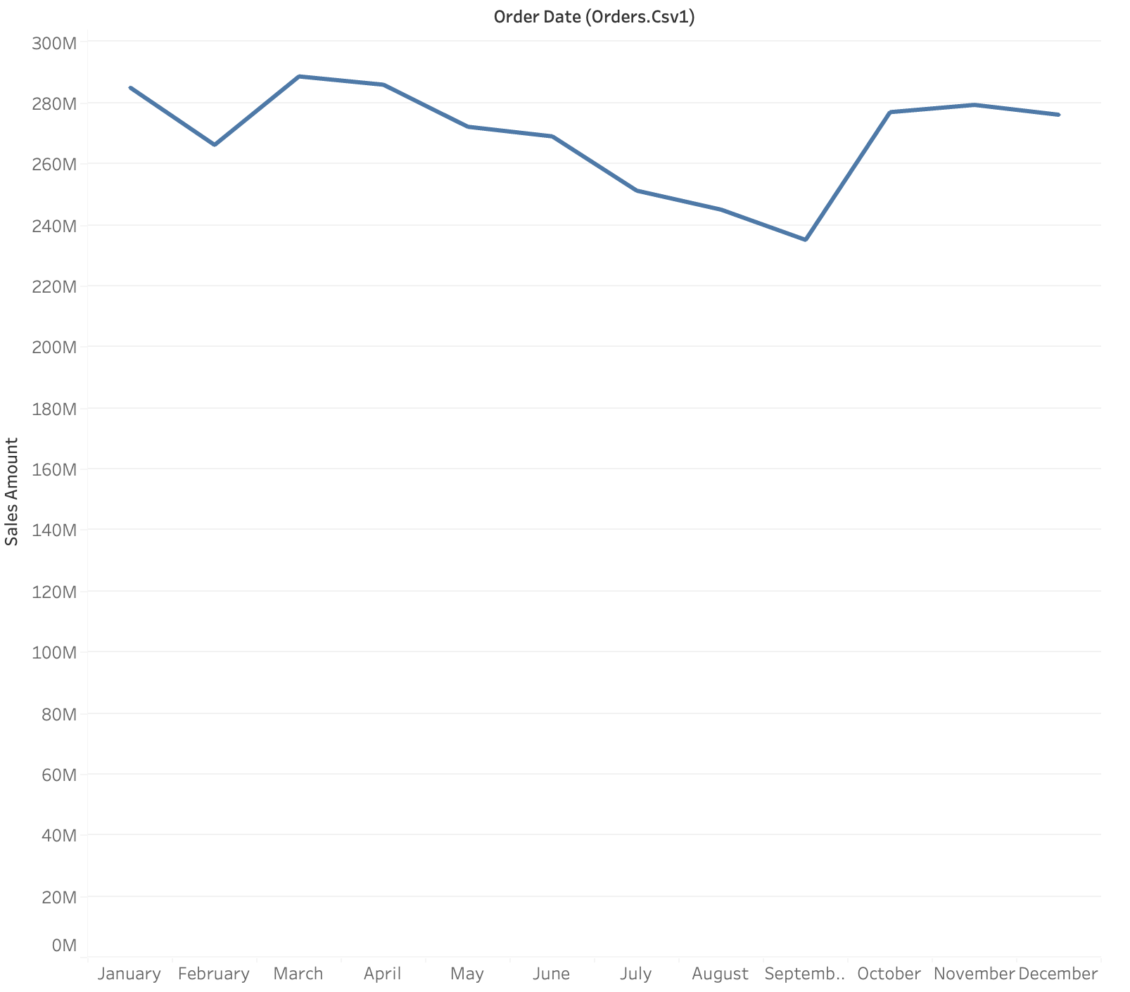
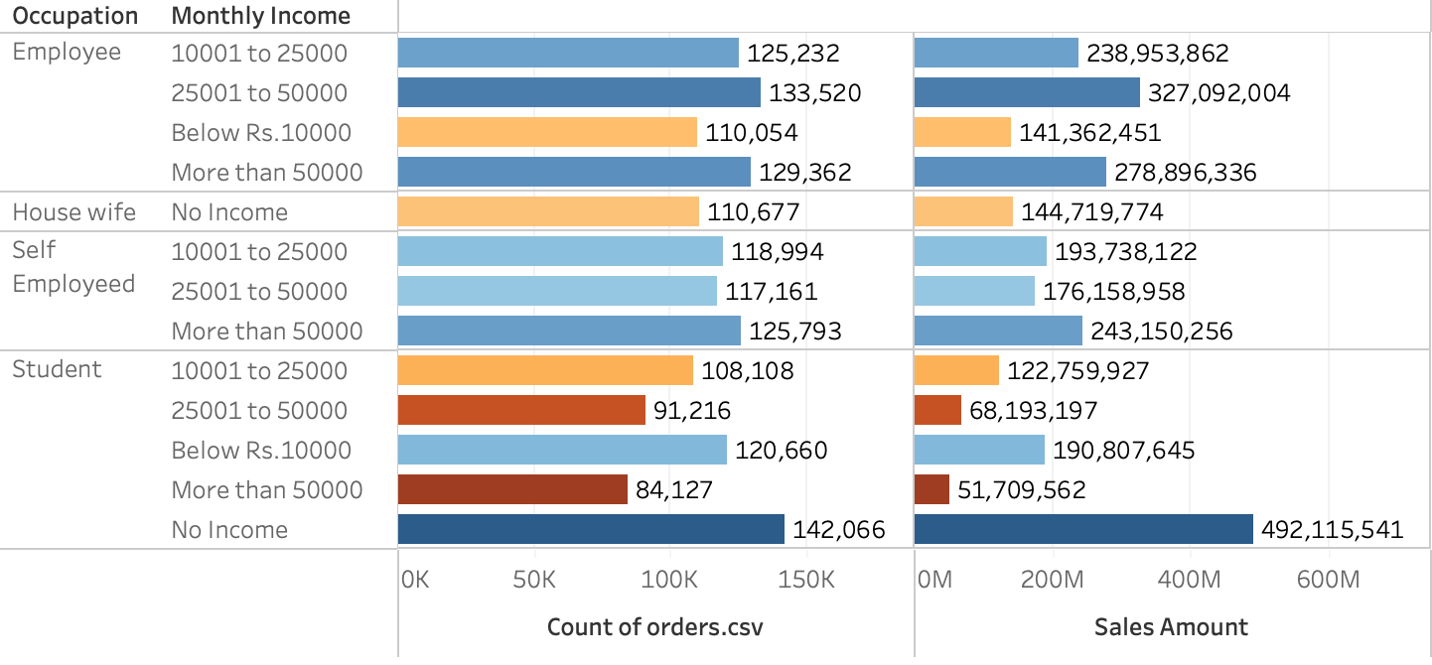
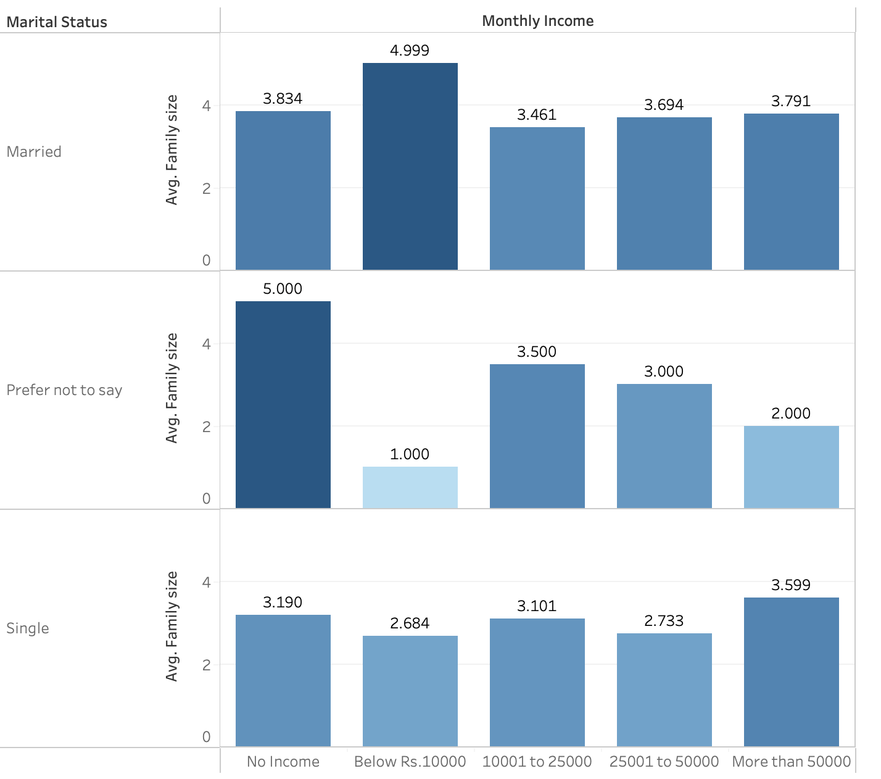
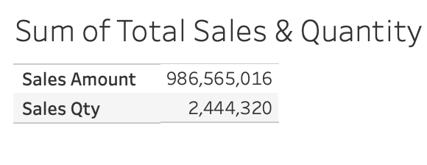

Slide 4
Demographic Findings
Most buyers are students (no income) or middle-class employees with an income between 25K to 50K Rs.
Majority of purchases come from both (male and female) students with no income.
Men make up majority of the buyers with a collective 530K buyers as opposed to their counterparts who make up 478K of buyers.
Zamato’s sales best profit month is March with an impressive 288 million in sales while its lowest month is September with 235 million.

Slide 5
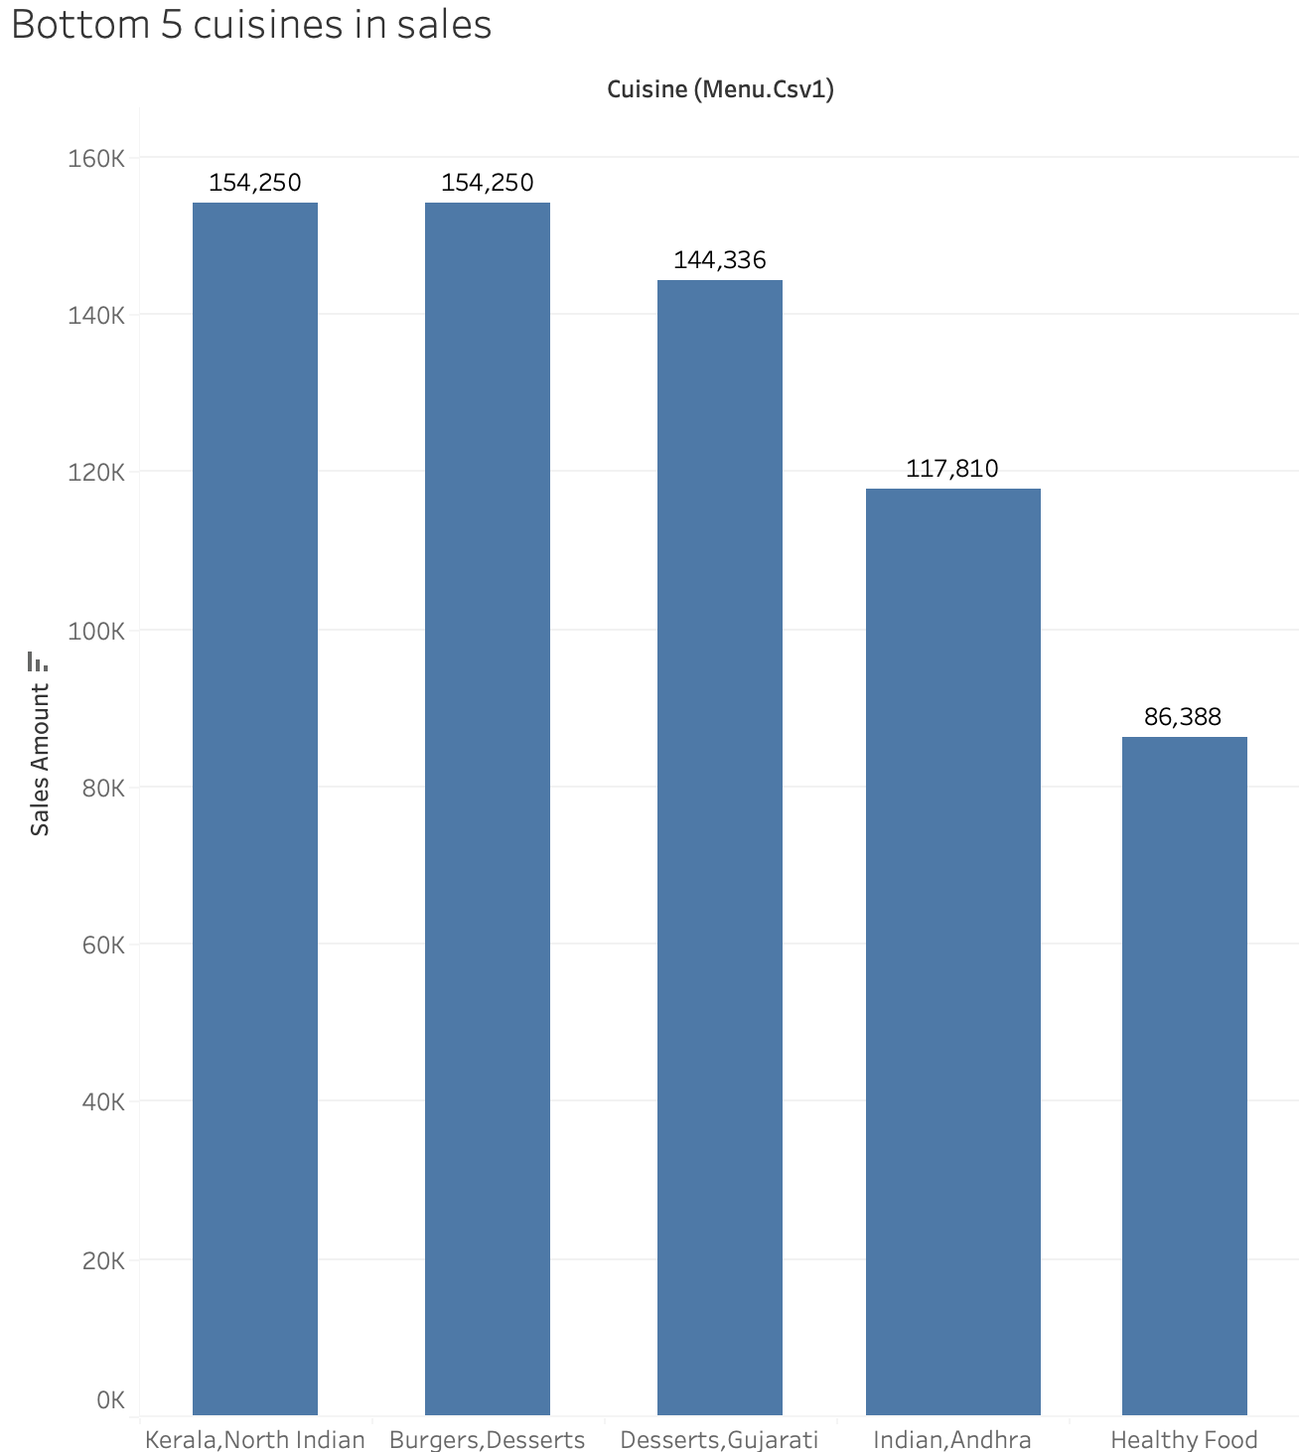
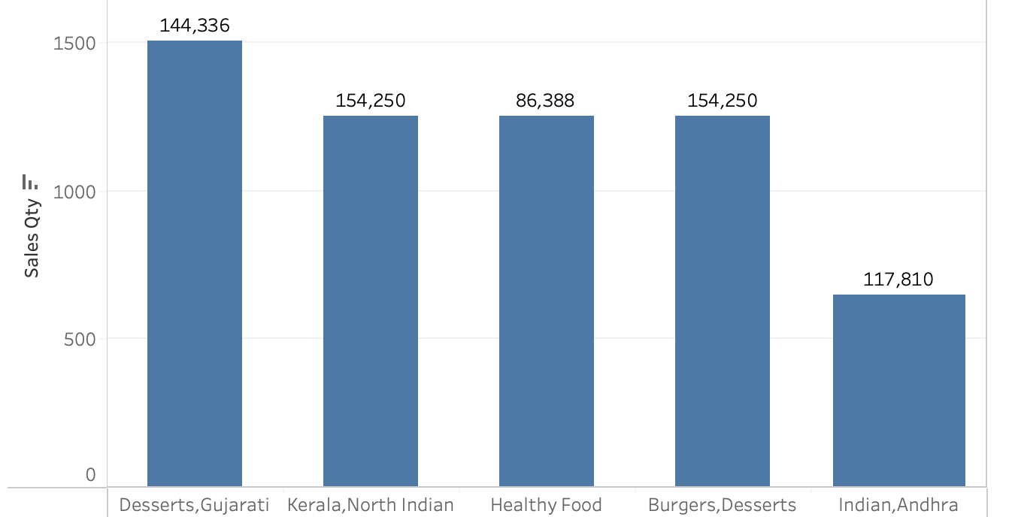
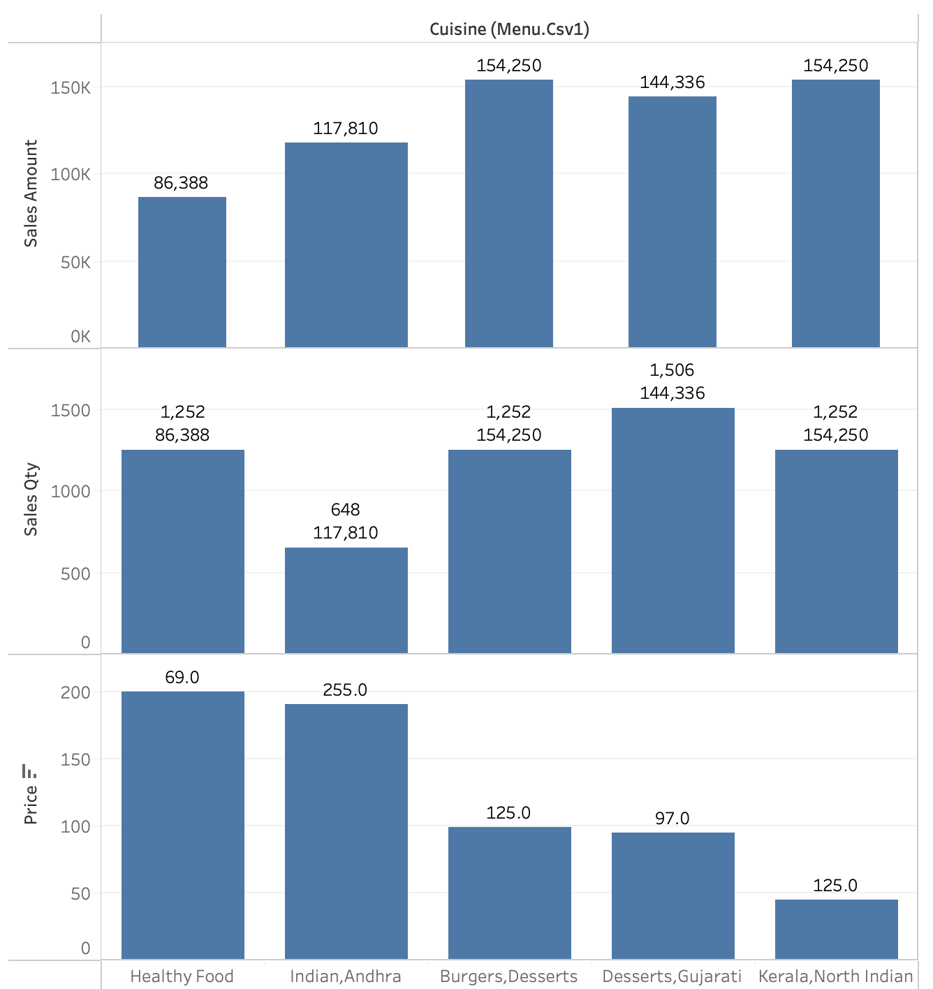
Bottom 5 cuisines based on sales/occupation

Slide 6
Low sales of the bottom 5 cuisines
Majority of the sales come from students with no income.
The Deserts, Gujarati cuisine is third on sales of the bottom 5 cuisines, but it holds the highest seller in terms of quantity of the group.
The lowest seller based on quantity is Indian, Andhra with only 648 sales.
Based on records with the pricing of these cuisines, healthy foods are the most expensive and yield to only the lowest of total sales while the Kerala, North Indian are the least expensive and yield the most in total sales.

Slide 7
Summary of Findings
The largest buyers of Zomato’s is students with no income and middle-class employees with an income of 25K to 50K.
The least expensive cuisine yields the most in sales of the bottom 5 selling cuisines, while the most expensive is losing profit based on sales (healthy foods).
The lowest sold cuisines make up only 0.07% of the total sales of Zomato’s restaurant sales.
These findings can be important for the marketing team to target the students and middle-class group and try to improve sales of the lowest selling cuisines to better profits.

Slide 8
Recommendations
Offer discounts to middle-class and students as a loyalty program to retain their purchases as a gratitude and a referral bonus as a way to acquire new buyers.
Have marketing do surveys to get information on why certain groups don’t purchase these cuisines and how to improve based on the feedback.
Offer a limited time promotion of purchase 1 get half price of other items as an attraction to new buyers.

